Slide 1

Retail 101
Overview of the Business Domain

Slide 2

Agenda
What is Retail?
Foundational Elements of Retail
Retail and Supply Chain of Consumer Goods
Top-down Process Map of Retail – L0 level
Top-down Process Map of Retail – L1 level
What Makes Retail Unique?
Owners of the Processes in a Retail Organization
Why Do Retailers Need Software?
Evolution of Customer Engagement Models in Retail
Retail Math

Slide 3
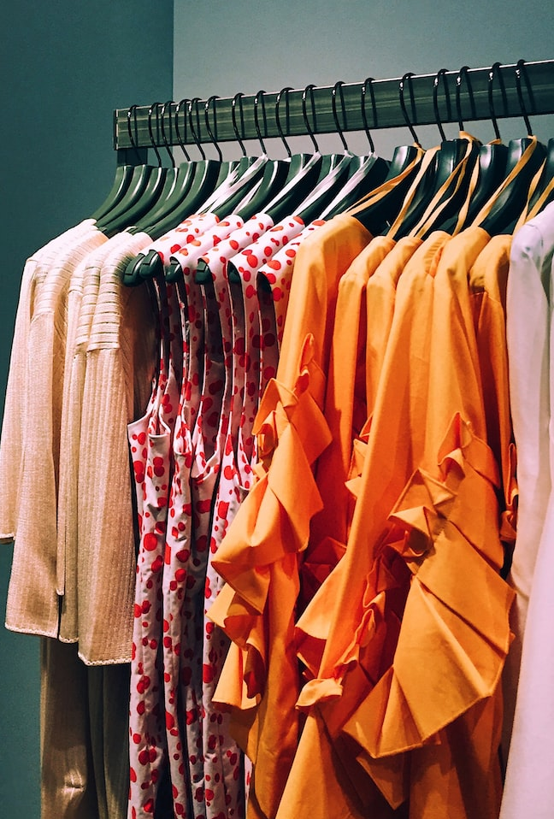
What is Retail?
Retail
Sale of consumers goods to the end-customers in relatively small quantity for final consumption
Retailer
The Retail Triangle
Customer
Goods/Products

Slide 4
What is Retail?
Retailing includes all business activities that involve the sale of goods and services to consumers for personal, family, or household use
What do retailers do?
Break-bulk
Provide assortment
Convenience of location / distribution breadth
Promotion
Value-added services
Notes:
TRIVIA If Wal-Mart were a country, what rank would it have in the world's economy?
a) 10
b) 20
c) 30
d) 40
Answer c) 30, right after Saudi Arabia

Slide 5
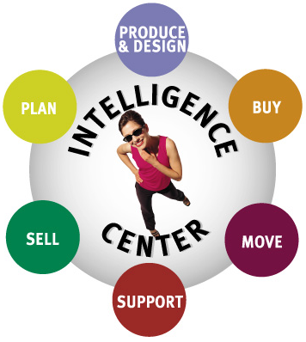
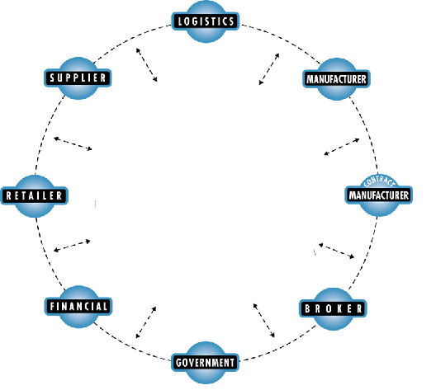
Retail Footprint
Retail is all about selling
Retail is forming relationships and partnerships with your suppliers
Retail is about the Customer
“Retail is Detail”
Notes:
This slide gives you an overview of what Retailing is all about.
First of all it illustrates what the whole industry is all about – it’s about selling. That’s why the consumer is in the middle, Surrounding the customer is an Intelligence Center. The Intelligence Center is all about understanding your customers, knowing how your business is performing, being in tune with market trends, etc.
The next level describes the fundamental functions a retailer performs. Starting in the upper left circle with Planning and moving clockwise to Production & Design, Buying, Logistics, Support, and finally Selling.
The outer ring represents your trading partners, vendors, and other external organizations. Notice that these are not arranged in a sequential supply chain. Instead, they are networked together. Everyone needs to understand how they ultimately impact the customer, not through a series of disparate transactions, but via an interlinked, dynamic, network.
The Intelligence Center flows throughout the framework and illustrates the need for gathering market intelligence, understanding how your business is performing, supporting decisions based on both market intelligence and business performance, and then finally monitoring exceptions and identifying threats & opportunities.

Slide 6

Retailer’s Challenge …
Retail is Detail
100’s or 1,000’s of Stores
X
50,000 SKUs
X
52 Weeks
X
4 Measures (Sales, Inventory, Receipts, On Order)
X
Plan, Actuals, Last Year
X
4 Seasons
Billions to Trillions of Numbers

Slide 7


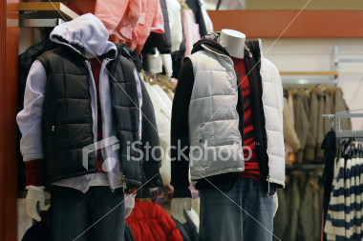
What do Retailers care about?
Increasing share holder value
Maximizing Profit
Increase return on inventory investment
Increasing Margin
Protecting their market share and profitability
Acquisition and retention of customers
Reducing time, cost, inventory holdings
Improve inventory visibility
Optimizing labor resources and capital
Localizing assortments
Managing growing and changing assortment

Slide 8
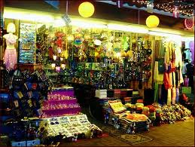

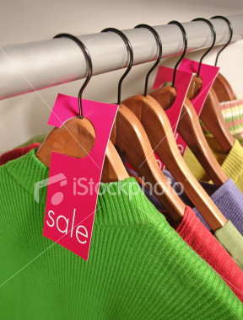
Age Old Problems
Lost Sales due to out of stocks
Wrong assortment - does not match local demand
Over stocked - Capital tied-up in non-selling product
Over assorted - Too many choices confuses customer
Poorly utilized space
Excessive markdown due to slow selling product
Eroding profit due to markdowns
Notes:
Lost sales due to incorrect allocation
Generic assortment does not meet customers demand – apparel – wrong colors and sizes, food wrong flavor, hardlines
Buyers pad their inventory to insure sales but really this decrease the rate in which they turn inventory which is one of the key measure they are measured against.
Consumers are overwhelmed with the number of choices. Just how many different types of Crest tooth paste are there?
All measure tie back together. Too much inventory = markdowns, slow sell thru of inventory = markdowns, markdown = erorsion is margin and decreased sales, lost sales = decrease sales = can mean over stocks later = markdown = lost margin.

Slide 9



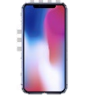
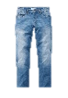
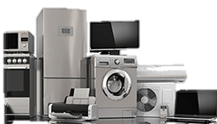
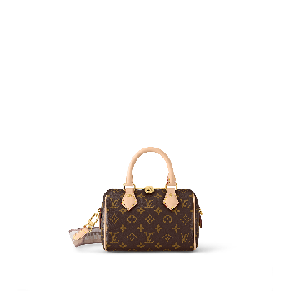


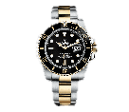
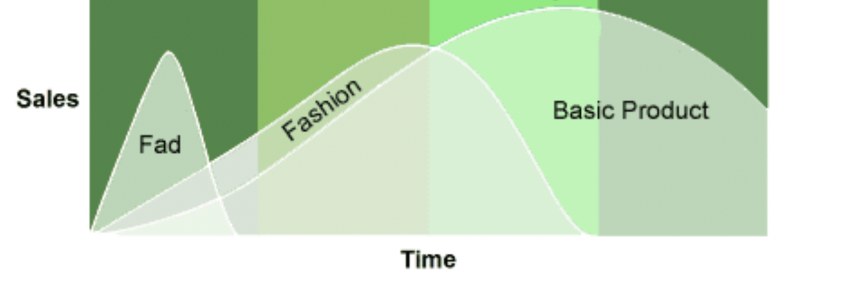
Foundational Elements of Retail – Consumer Goods
Consumer goods
Convenience goods
Goods bought by customers for final consumption
Always sold to and used by end-consumers
Other terms – Consumer products, final goods, items, merchandise or just products
Shopping goods
Specialty goods
Supplementary details
Lifecycle of consumer goods
Lifecycle of consumer goods (apparel)
A product life cycle is the amount of time a product goes from being introduced into the market until it's taken off the shelves
Supplementary details

Slide 10
Foundational Elements of Retail – Retailers
Retailers and the Product Types in Retail
Food and grocery
Softline
General Merchandise
Hardline
Specialty
Luxury
Retailers by type of products
Retailers
Merchants who are involved in retailing of consumer goods to make profit
A bit of history trivia! - The term “merchandise” is derived from French word “Marchand” which means merchant
Retailers and the Retail Formats
Grocery Store/Supermarket
Convenience Store
Department Store
Big-box store (Hyperstore/Superstore)
Off-price Store
Factory Outlet
Dollar Store
Warehouse Club
Online Store

Slide 11
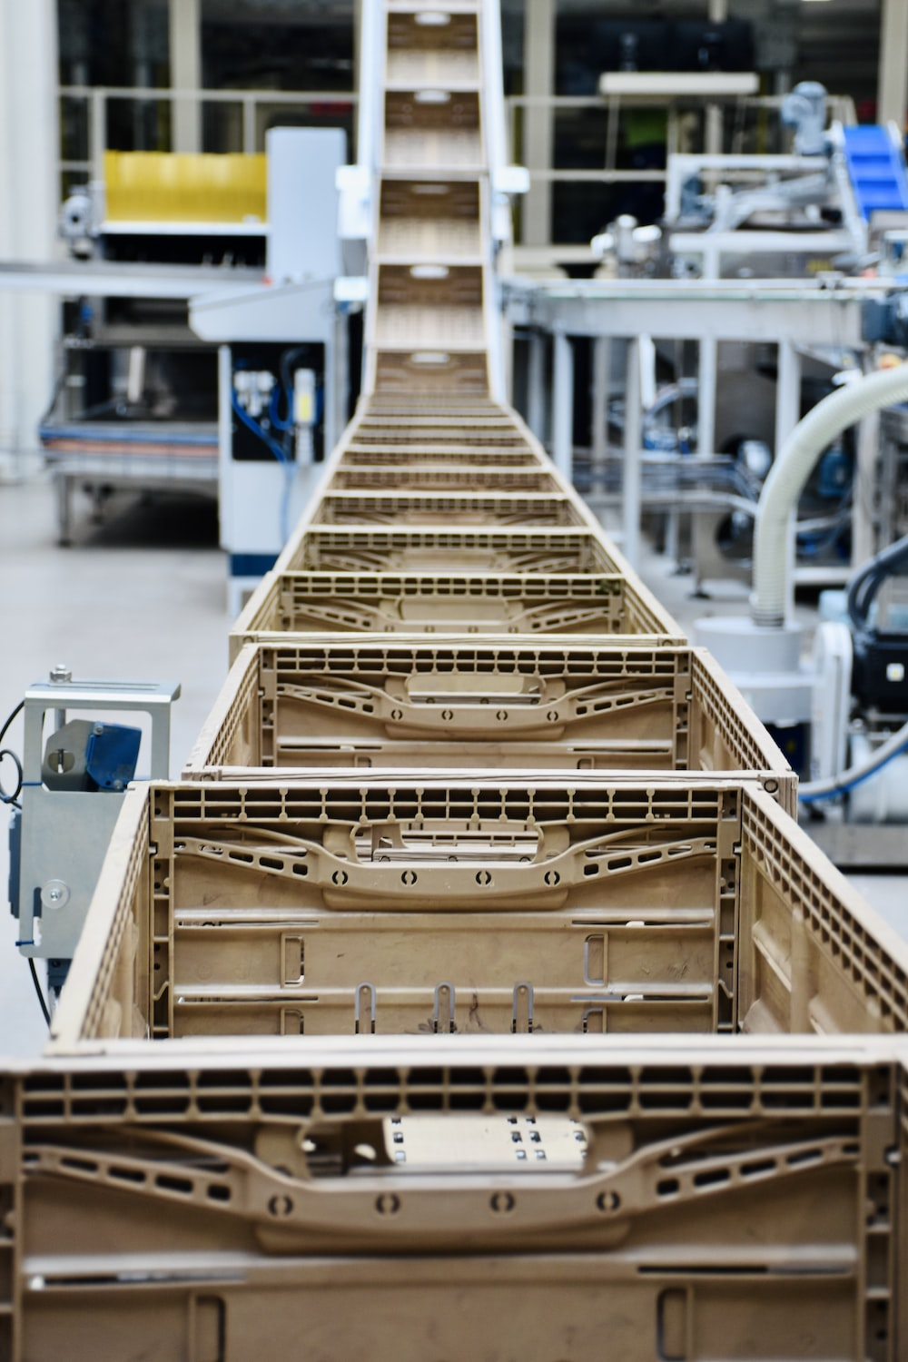
Retail and Supply Chain of Consumer Goods
Product
Money
Information
Supplier
Manufacturer
Distributor
Retailer
Customer
Retailer connects products to consumers
Significance of retail in the supply chain of consumer goods
Understand and shape demand, inform upstream
Provide product assortment
Offer service & support to customers
Be the first buffer for supply chain disruptions

Slide 12

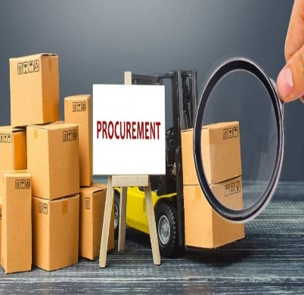
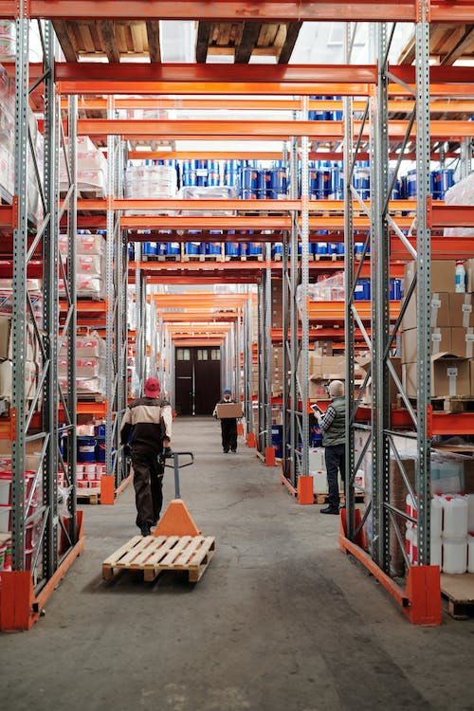
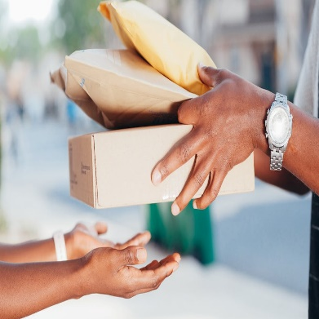

Top-down Process Map of Retail – L0 level
01
02
03
04
PLAN
PROCURE
MOVE
SELL
Process of anticipating demand for products and planning supply. Stepping-stone for sourcing, distribution and sale to meet sales and margin targets
Process of acquiring merchandise to sell later. Sourcing can either be own production or buying ready-to-sell products
Process of getting merchandise into the business, and distributing through different channels to make their way to the final consumers
Final step of the supply chain where a retailers consumers get the products into the hands of its customers
Click here to see different business models
Data and Analytics

Slide 13
Top-down Process Map of Retail – L1 level
Plan
Demand Forecasting
Merchandise Financial Planning
Range Planning
Store Grading
Assortment Planning
Buy Plan
Analytics and Insights
Merchandise Control - OTB
Size scaling and pack optimization
Allocation & Replenishment plan
Product pricing
Presentation & placement
Supplementary details
Buy
Sourcing and contracting
Purchase Order management
Tracking and notification
Goods
Receipt
Invoice & payment
Vendor management
Spend Management
Supplementary details
Move
Receiving
Put-away
Distribution
Customer Order Fulfillment
Pick, Pack & Ship
Customer Returns
Inventory Count
Return to Vendor
Supplementary details
Sell
Marketing
Service
Promotions
Loyalty
Personalization
Visual Merchandising
Pre-sales & after-sales service
Returns & refunds
Order tracking
Commerce
Fulfillment
Store Ops
Digital Channels
Search & discovery
Inventory Visibility
Payments
Order promise
Order fulfillment orchestration
Shipping
Foundational
Customer Data
Employee data
Product information management
Content & digital assets
Transaction audit
Stock ledger

Slide 14
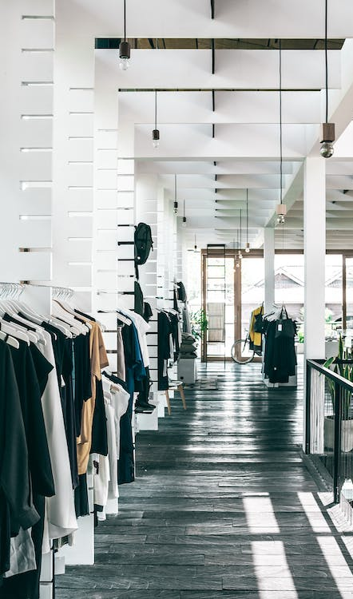
What Makes Retail Unique?
Demand Planning vs
Merchandise Planning
Complexities of Inventory Management
Unlike other industries, planning in retail is not just predicting the sales
Retailers require to plan for an assortment of products residing in a complex product hierarchy and offered in the form of multiple SKUs across different stores and channels
Merchandise planning ensures right merchandise is offered to the customers at the right time and place
Distributed inventory across multiple stores and channels with distinct demand patterns, space availability and localization needs
Manage different life cycle products
Manage multiple levers for inventory management– promotions, markdowns etc. on the demand side and product postponement, dropship vs inventory holding etc. for supply
Proliferation of channels
Stores create uniqueness
to retail
Customer touchpoints in retail are only on an upward spiral
Customer journeys decussate multiple channels and a seamless omnichannel experience is imperative
New channel puts a lot of pressure on retailer’s margins that are already relatively smaller
In B2B industries, channels are limited and demands are inversely correlated
Stores have uniqueness in demand driven by localized factors, and microeconomic conditions
Top-down planning requires reconciliation with bottom-up planning by the stores
Usually operate in silos and mostly communicate only with corporate
Any change in stores consumes time and effort and usually a slow process

Slide 15
Process Owners in a Retail Organization
CEO
COO
Head of Logistics
Warehouse Manager
Transportation Manager
Head of Store Operations
Area Manager
Store Manager
Visual Merchandising Manager
Sales Manager
Head Cashier
Back of House Manager
CFO
Financial Planning
Finance Controller
GMM
Head of Buying
Buyer
Head of Merchandising
Planner
Allocator
Inventory Controller
CIO
Head of Technology Services
VP of Enterprise Apps
VP of Consumer Apps
CISO
Chief Data Officer
Data Architect
Data Scientist
Data Analyst
CDO
Head of Marketing Communications
Head of Brand Marketing
Head of Digital Marketing
Head of Loyalty Program
Head of Marketing Analytics
CHRO
Head of HR
Head of C&B
Head of Recruitment
Head of L&D
VP of Marketing
VP of Digital Commerce
Head of Branding
Head of Content
Head of Customer Acquisition
Organizational Chart of a retail company

Slide 16
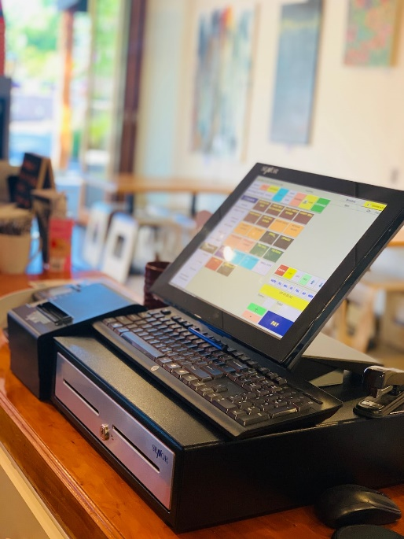


Why do Retailers need Software?
“
“
Software are enablers of the business processes
Task automation
Efficiency
Less error-prone
Scale
Speed
Market reach
Higher productivity
and more…
Notes:
alessio-zaccaria-MplUOXqEUK0-unsplash.jpg

Slide 17
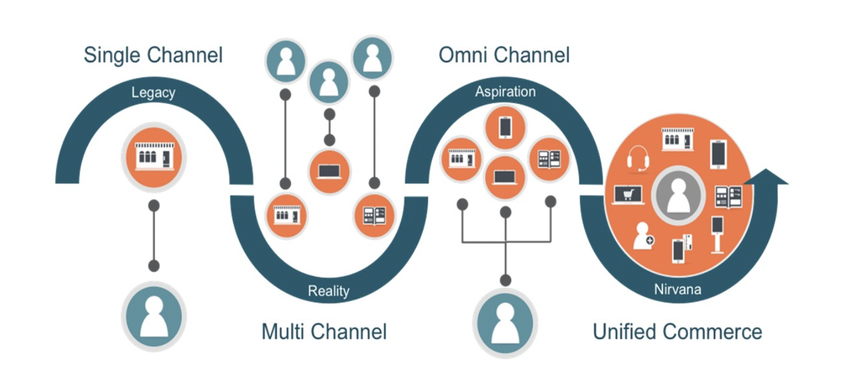
Evolution of Customer Engagement Models
SINGLE CHANNEL
MULTI CHANNEL
OMNI CHANNEL
UNIFIED COMMERCE

Slide 18
Evolution of Customer Engagement Models
Retail Industry Commentary
Brick-and-mortar retailers have to think of e-commerce as a serious business in its own right and not compromise its success in an effort to protect the traditional physical model - Getting Real About Virtual Commerce, HBR, 1999
SINGLE CHANNEL
MULTI CHANNEL
Retailer offers only one channel (mainly offline) to sell products to customers
Conventional operating model followed in retail until internet disrupted it
Retailer offers multiple channels to sell products
Every channel acts independently of each other
Process and data exist in technical and functional silos
Most e-Commerce retailers place initial emphasis on the “exciting” areas: Web product development, traffic generation, etc. Often, they give little thought to order fulfilment—a capability critical to the success or failure of Web commerce - Order Fulfillment: The Hidden Key to e-Commerce Success, 1999
“We had a very steep learning curve, but we’re getting a lot better at e-commerce. We’ll be the first multichannel retailer to offer pervasive service on a massive scale” - Stephen Riggio, Barnes and Noble’s Vice-chairman, 2001

Slide 19
Evolution of Customer Engagement Models
Retail Industry Commentary
Omnichannel shoppers will spend over 20 percent more than multichannel consumers – IDC report, 2010
SINGLE CHANNEL
MULTI CHANNEL
OMNI CHANNEL
Retailer offers only one channel (mainly offline) to sell products to customers
Conventional operating model followed in retail until internet disrupted it
Retailer offers multiple channels to sell products
Every channel acts independently of each other
Process and data exist in technical and functional silos
Connected, consistent and coordinated customer across all channel and touchpoints
Requires one version of truth experience customers, merchandise, price, promo inventory, orders

Slide 20
Evolution of Customer Engagement Models
Retail Industry Commentary
Omnichannel is not just for the Front End anymore – Chain Store Age, 2013
SINGLE CHANNEL
MULTI CHANNEL
OMNI CHANNEL
UNIFIED COMMERCE
Unified commerce is now the number one priority for retailers and will drive the most technology spend – IHL, 2015
Retailer offers only one channel (mainly offline) to sell products to customers
Conventional operating model followed in retail until internet disrupted it
Retailer offers multiple channels to sell products
Every channel acts independently of each other
Process and data exist in technical and functional silos
Connected, consistent and coordinated customer across all channel and touchpoints
Requires one version of truth experience customers, merchandise, price, promo inventory, orders
One platform for multiple experiences
Practice of inter-connecting channels and touchpoints with their supporting back-end systems via a single platform

Slide 21
Convenience Goods, Shopping Goods and Specialty Goods
Dimension | Convenience | Shopping | Specialty
Examples | FMCG, non-durables | Consumer durables (fridge, tv, oven), furniture | Designer clothes, accessories, jewelry
Customer involvement | Low time and effort | High time and effort with examination and selection. The objective is to maximize the fulfillment of the functional needs while optimizing the cost | High with choice of brand, fit etc. It’s not just for meeting functional needs but also involves a level of prestige, privilege, and honor someone is perceived to have in society
Lifecycle | Very Long | Multi-period | Short
Frequency of purchase | High | Low | low
Variety | Low | Standardized | High (Zara has 10000+ styles in a year)

Slide 22
Convenience Goods, Shopping Goods and Specialty Goods
Dimension | Convenience | Shopping | Specialty
Pricing | Pricing is standardized. Profit margins are low | Generally costly products, though competitive pricing has impact | High
Profit margin | Low | High | High margin, low volume
Nature of demand | Regular and steady with predictability by using level, trend and seasonality | Less frequent, but repeats after a certain time | Unpredictable
Demand forecasting | Mostly Predictable with historical data | looks-like or analogous forecasting followed by using historical sales data while factoring in the lifecycle stage | Mix of quantitative such as looks-like and analogous forecast and qualitative such as focused group or delphi
Sales promotion | Less | At the time of launch | Aggressive at the time of launch
Price elasticity of demand | Less elastic | Elastic | Highly elastic
Brand loyalty | Average though price sensitivity may not be much relevant due to standardization in price | Average with high price sensitivity among the customer | High with low price sensitivity

Slide 23
Convenience Goods, Shopping Goods and Specialty Goods
Dimension | Convenience | Shopping | Specialty
Supply chain objective | Efficiency Postponement strategy – Mostly MTS | Postponement strategy – MTS but also possibility of ATO, MTO | Responsiveness (Meet demand with supply) as much as possible AND Flexibility Postponement strategy – MTS but also possibility of ATO, MTO. ATO/MTO can be helpful in saving time wastage and create more variation to meet specific choices
Inventory management | Replenish to restock with periodic review Build up inventory for peaks | Allocation followed by Replenishment | Single period mostly. Forward placement of inventory at the time of launch
Transportation management | Cost dominates speed Focus on achieving economies of scale with Ocean Freight, FTL and MOQ Cross-docking is preferred to move material from Vendors to Stores via a DC where suppliers from different suppliers and then load is built to send to the stores |  | Speed dominates cost

Slide 24
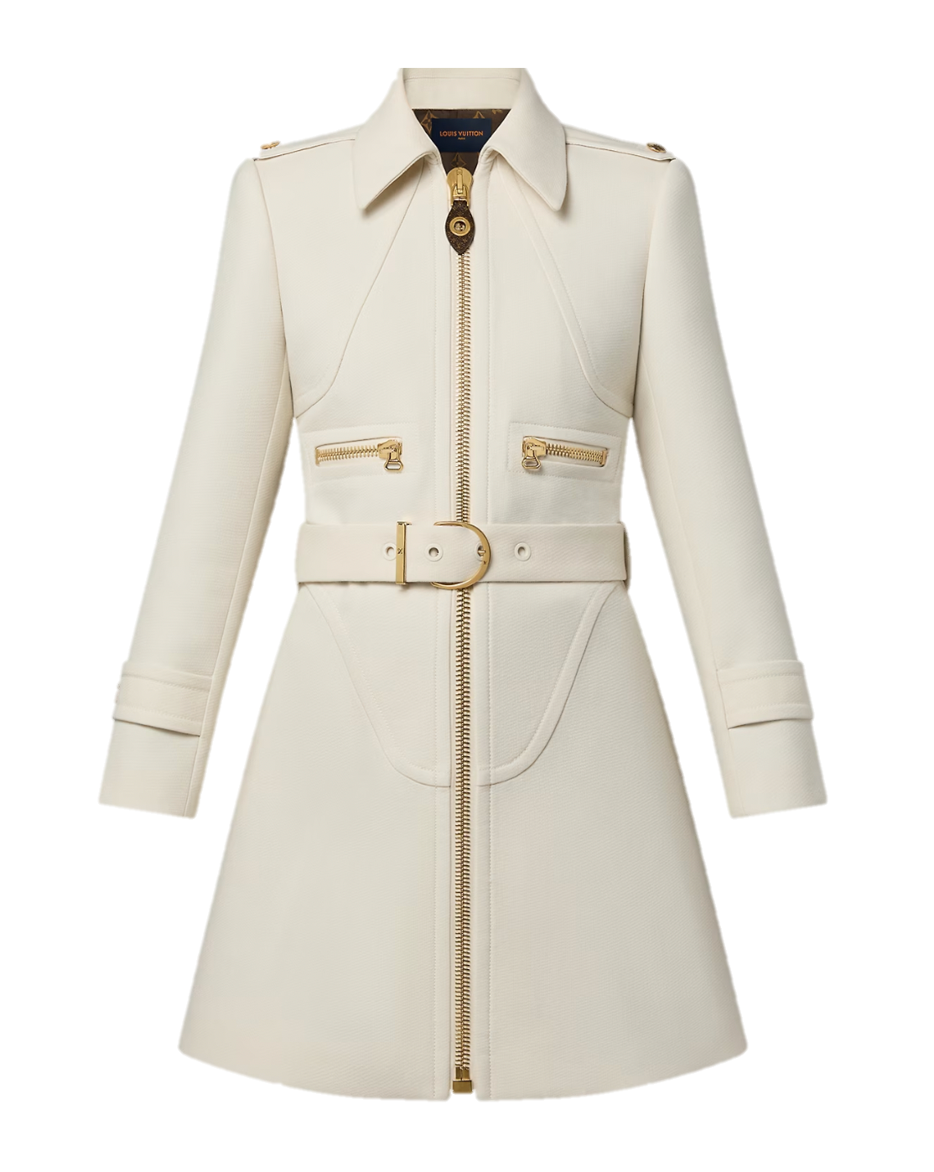
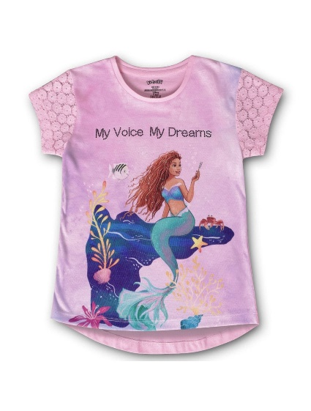
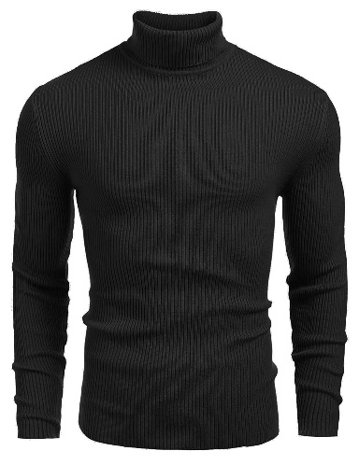
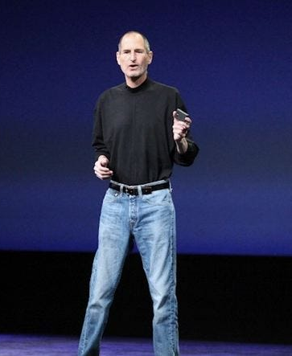
Basic, Fashion and Fad Apparel Products
Basic
Fashion
Fad
Long life cycle products that continue to sell for years
Sometimes referred as always-on-shelf products or core products
Distribution to store follows pull strategy where stock is replenished based on forecasted demand
Short life cycle products that lasts a seasons - Spring/Summer and Fall/Winter
Distribution to store follows push strategy where stock is allocated by the head-office to the stores
Follows planning in advance (designs start almost a year) and involves long lead-time in supply
Even shorter lifecycle than fashion products
demand rises suddenly due to collective interest of customers in the product.
Have a sudden surge in popularity, but quickly fade away - WIGIG
V/S
V/S

Slide 25
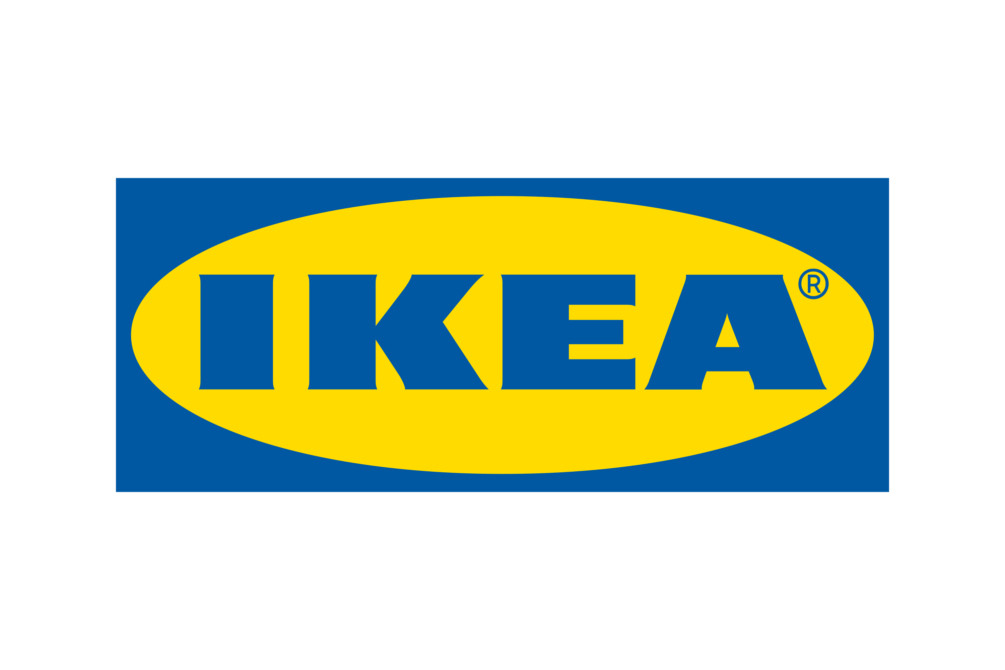









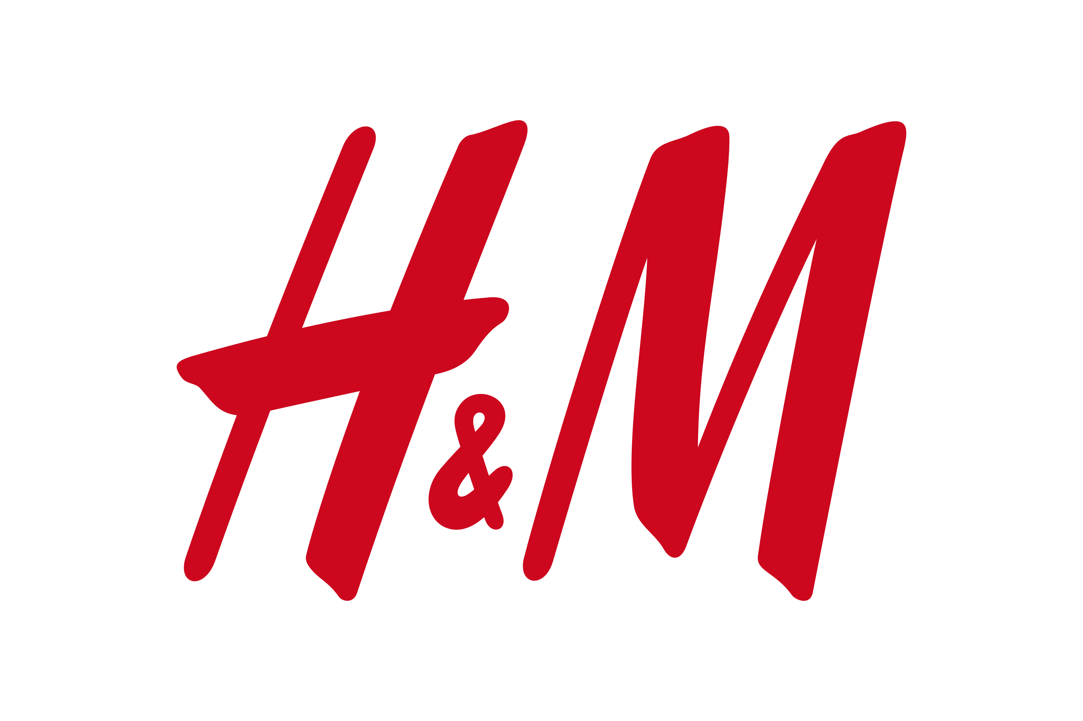



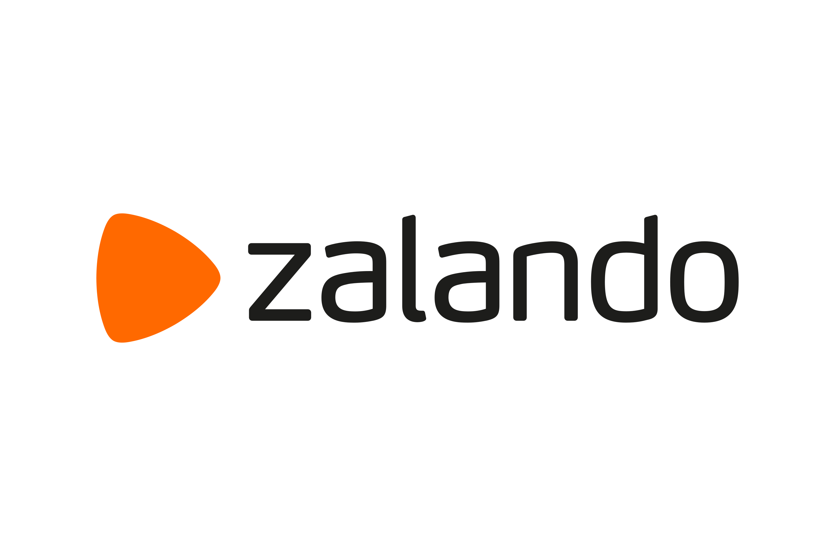



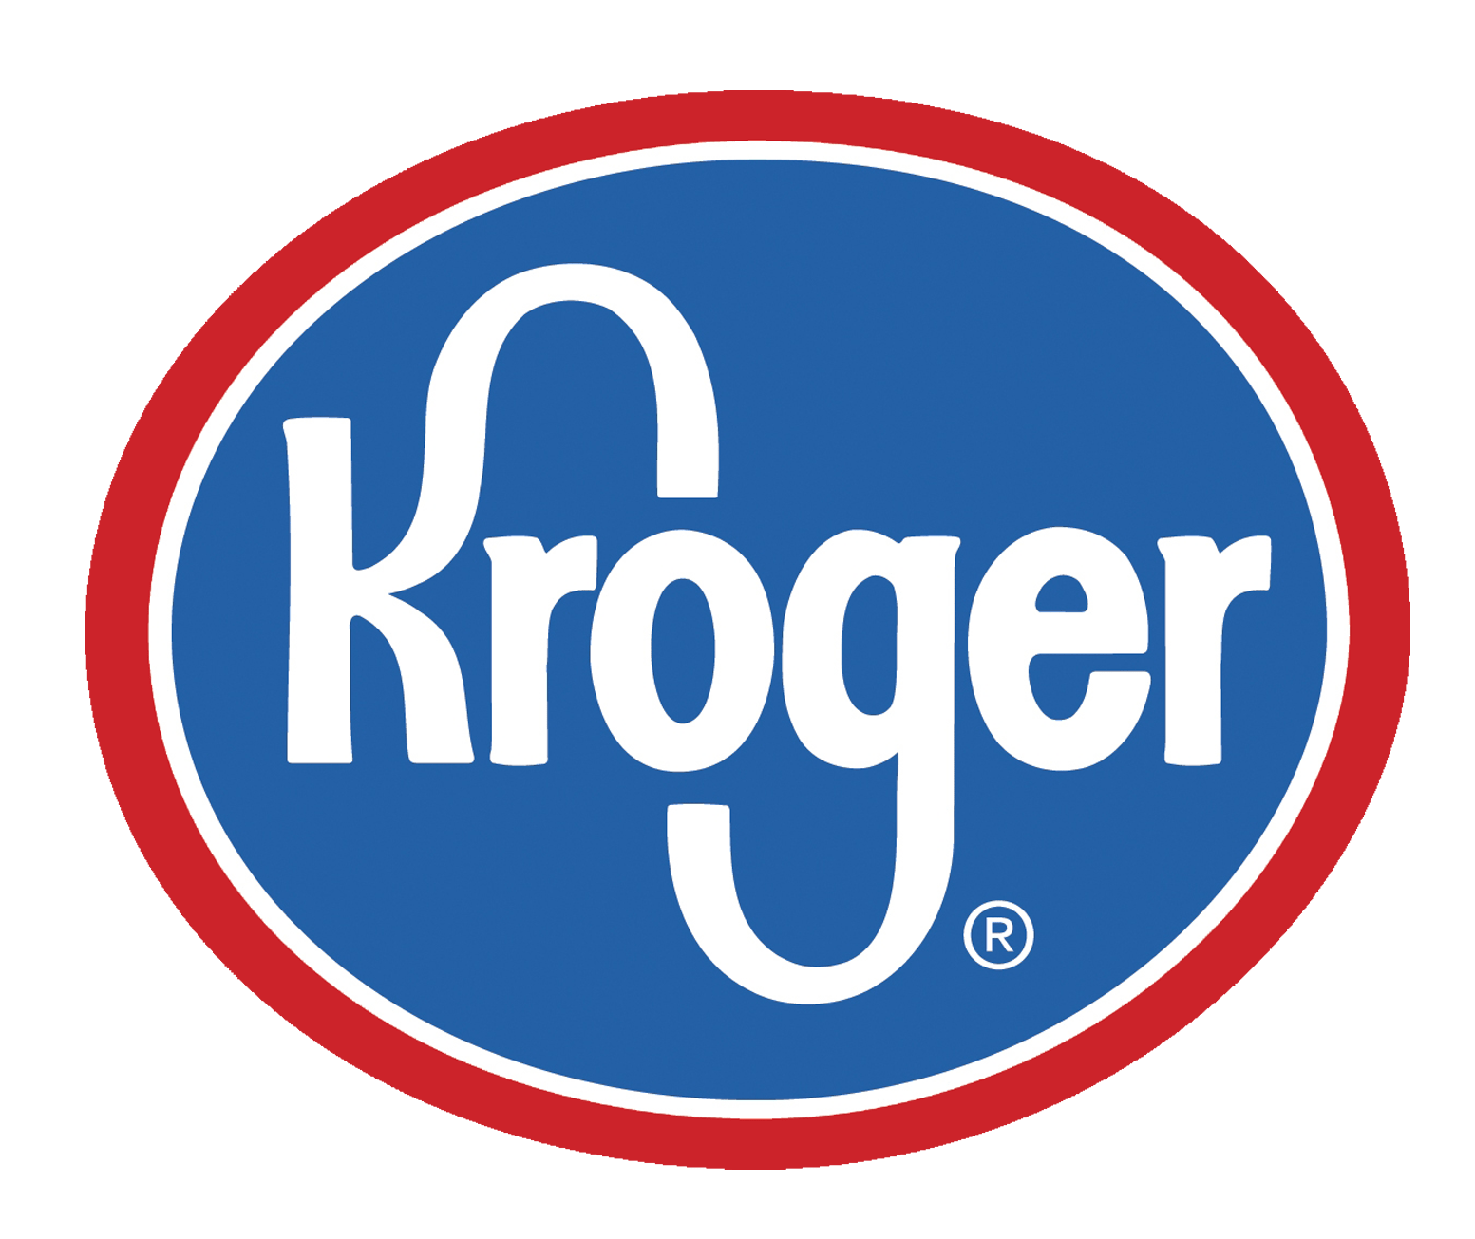
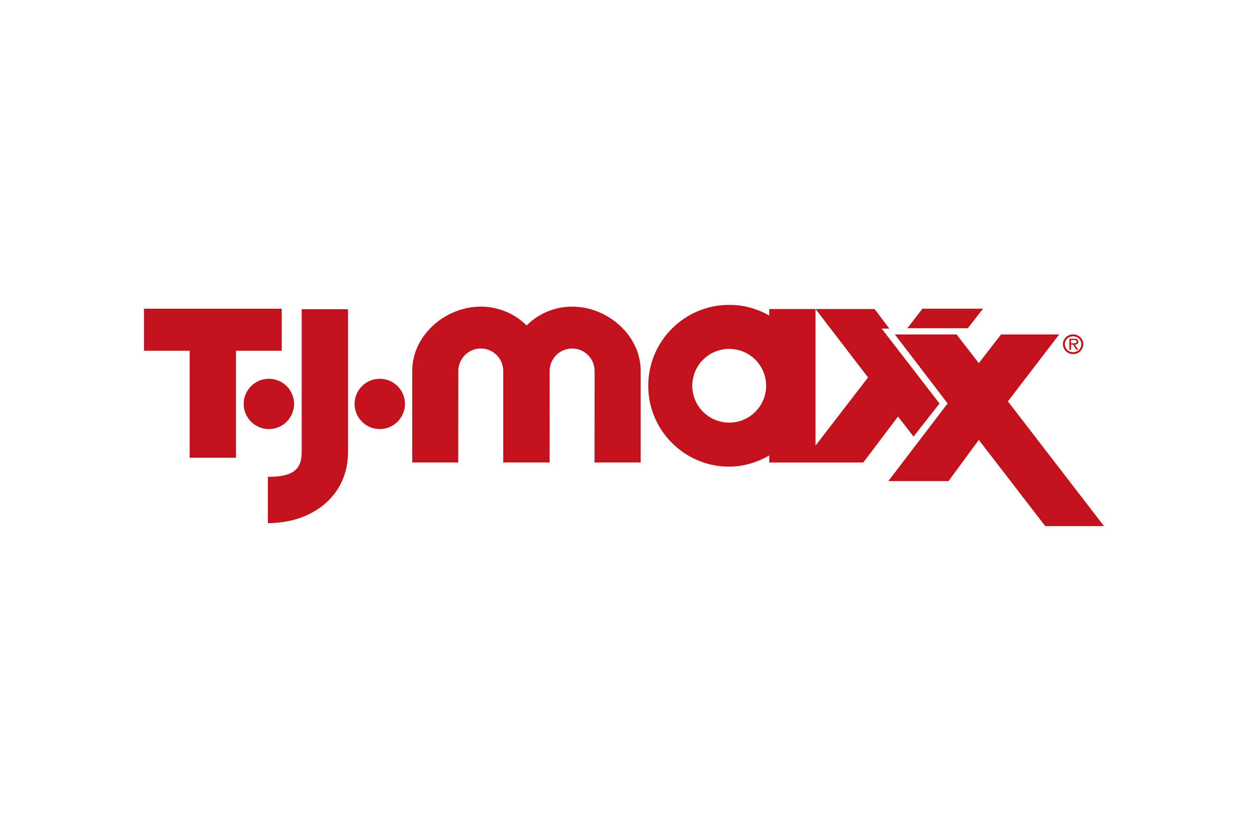
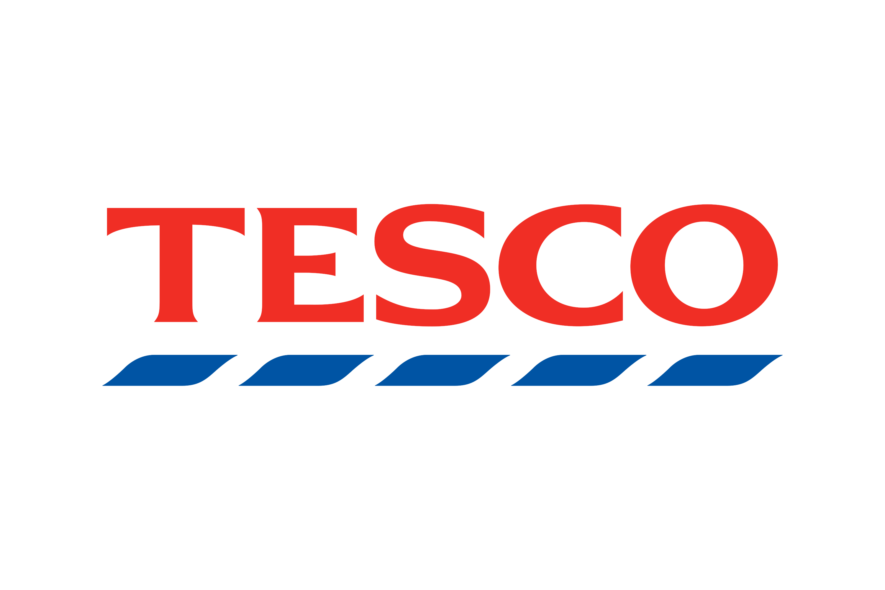

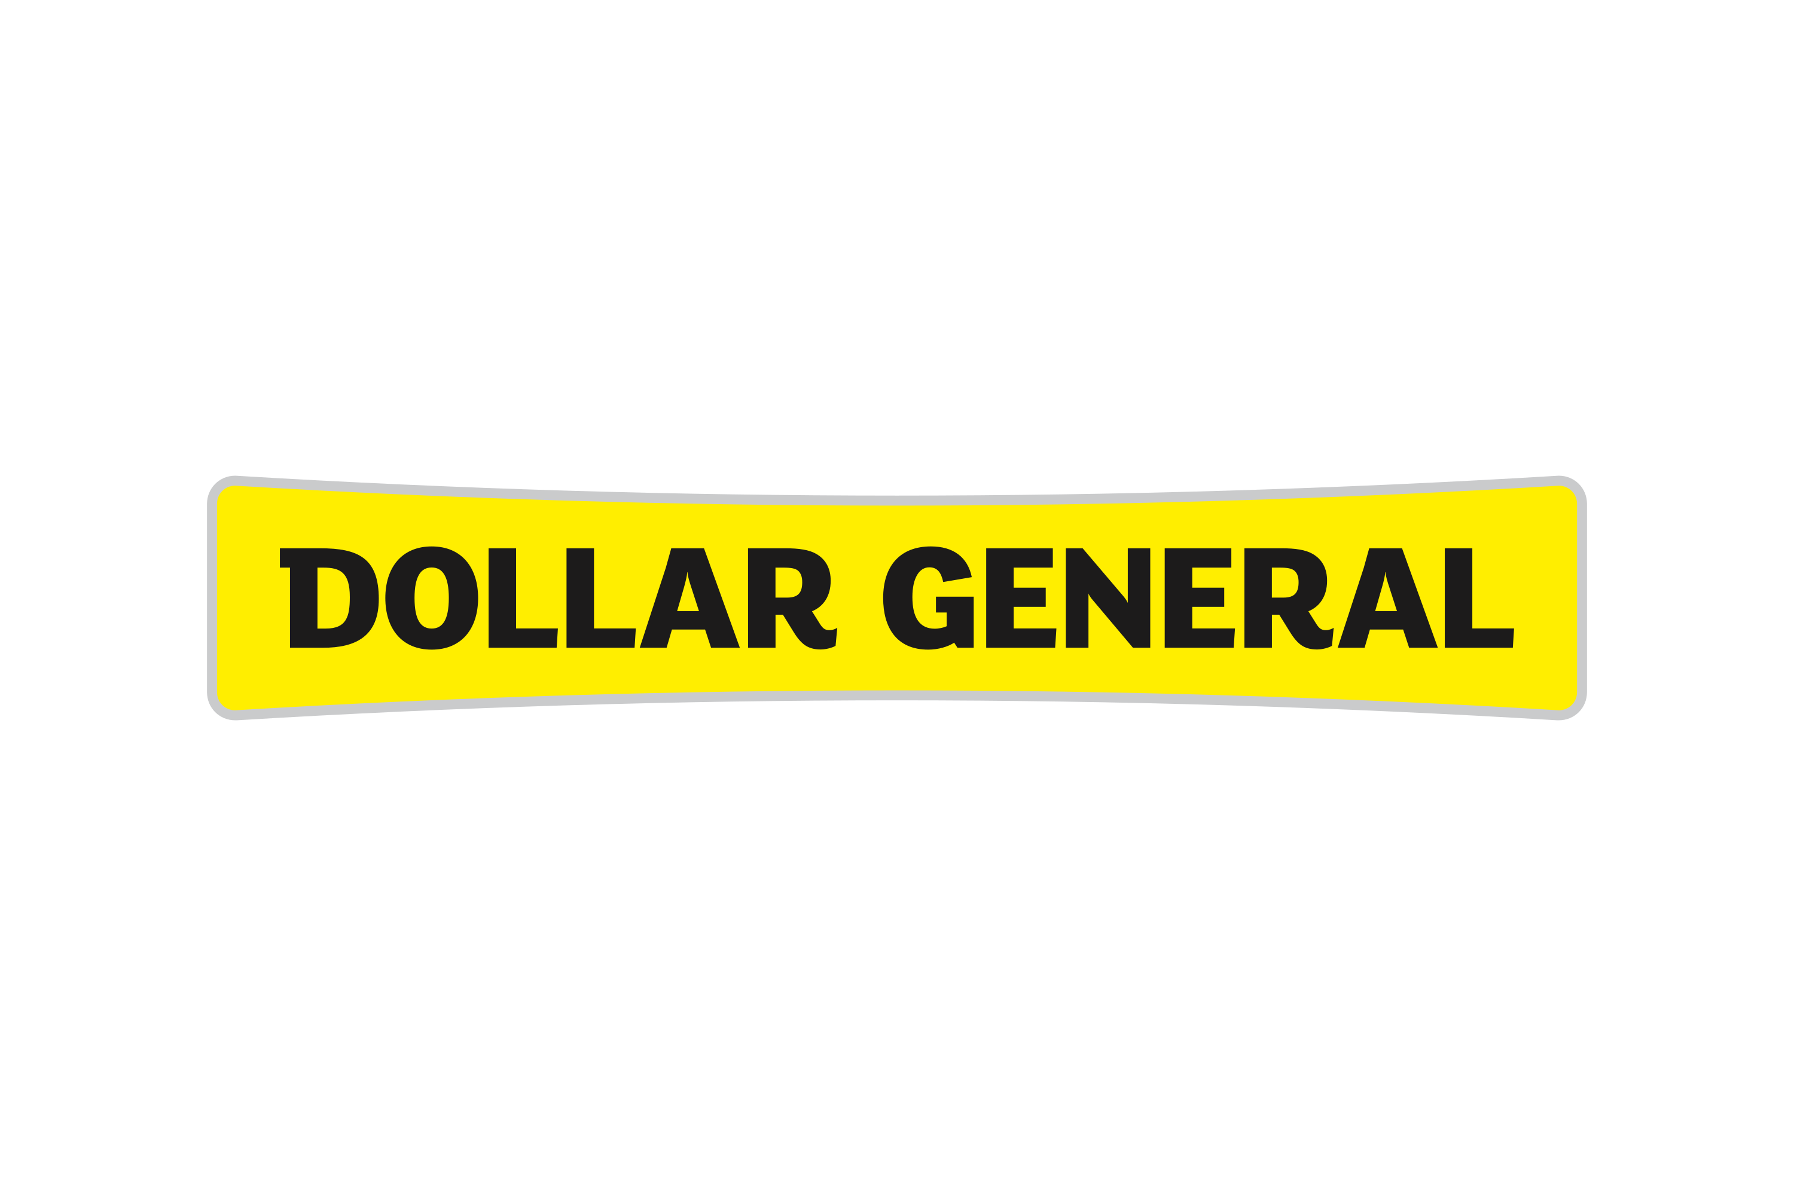
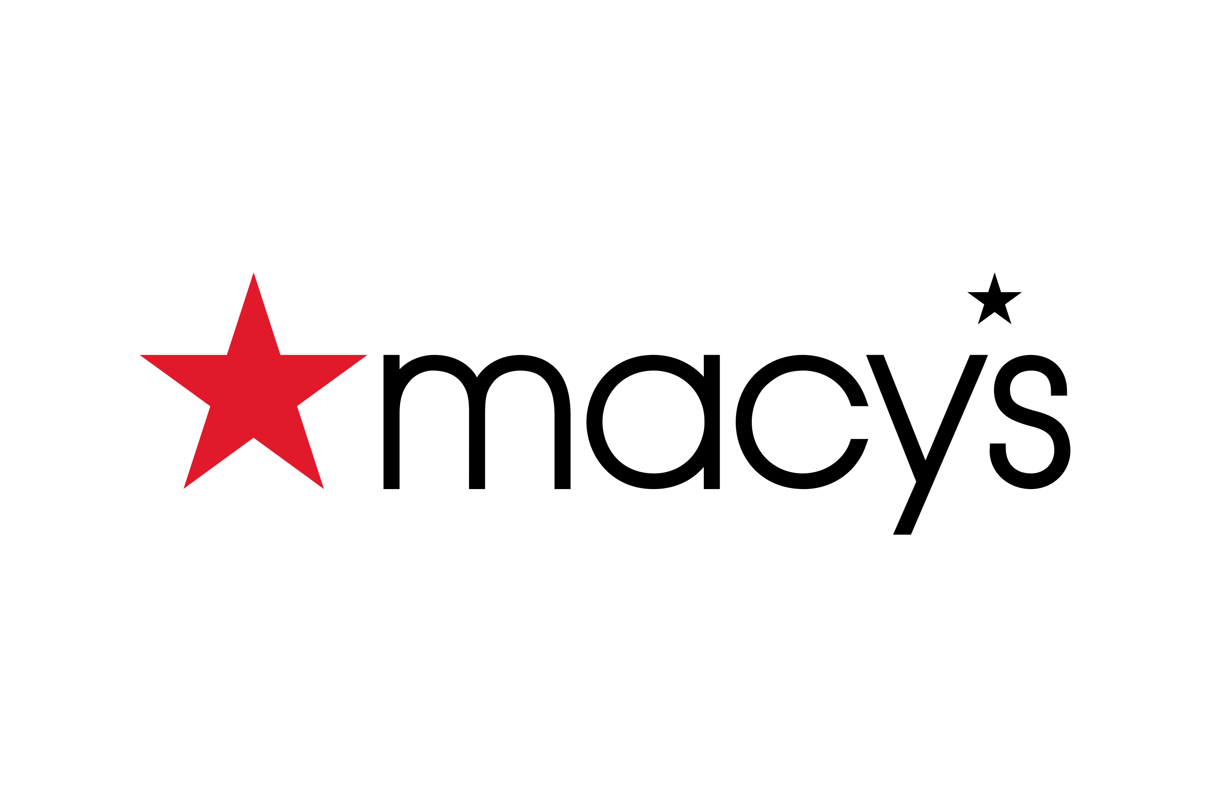

Retail Business Models
Vertical Retail
Controls one or more steps of flow of goods such as designing, manufacturing, wholesale distribution, distribution to stores etc. apart from eventual consumer sales
Vertical integration can be full or partial and forward or backward. Should be viewed in continuum instead of binary
V/S
Multi-brand Retail
Sells multiple brands under one roof
Retailer’s focus is on customer engagement and selling
Merchandise is sourced directly from the brands or the distributors

Slide 26
Merchandise Hierarchy in Retail
Company
Business
Fashion
Category/Division
Apparel
Department
Men’s wear
Class
Men’s shirts
Men’s classic fit formal shirt
Style
Style/Color
Men white Classic fit formal shirt
Men white Classic fit formal shirt Large
Style/Color/Size (SKU)

Slide 27
Order-To-Cash (O2C) and Procure-To-Pay (P2P) Processes
O2C process cycle
1
2
3
4
5
Receive order from the customer
Accept and fulfill the order
Ship the order
Send invoice to the customer
Record the payment
P2P process cycle
1
2
3
4
5
Identify requirement
(item, quantity etc.)
Create and approve purchase orders
Receive goods
Receive invoice and match the invoice
Pay the vendor
Process type | Purpose of the process | Organization roles
Order-To-Cash (O2C) | Processing orders from clients and realize revenue | The sales, accounts receivable, and product shipping or inventory management teams
Procure-To-Pay (P2P) | Sourcing and paying for the products and services from the suppliers | The procurement and purchase team, accounts payable department

Slide 28
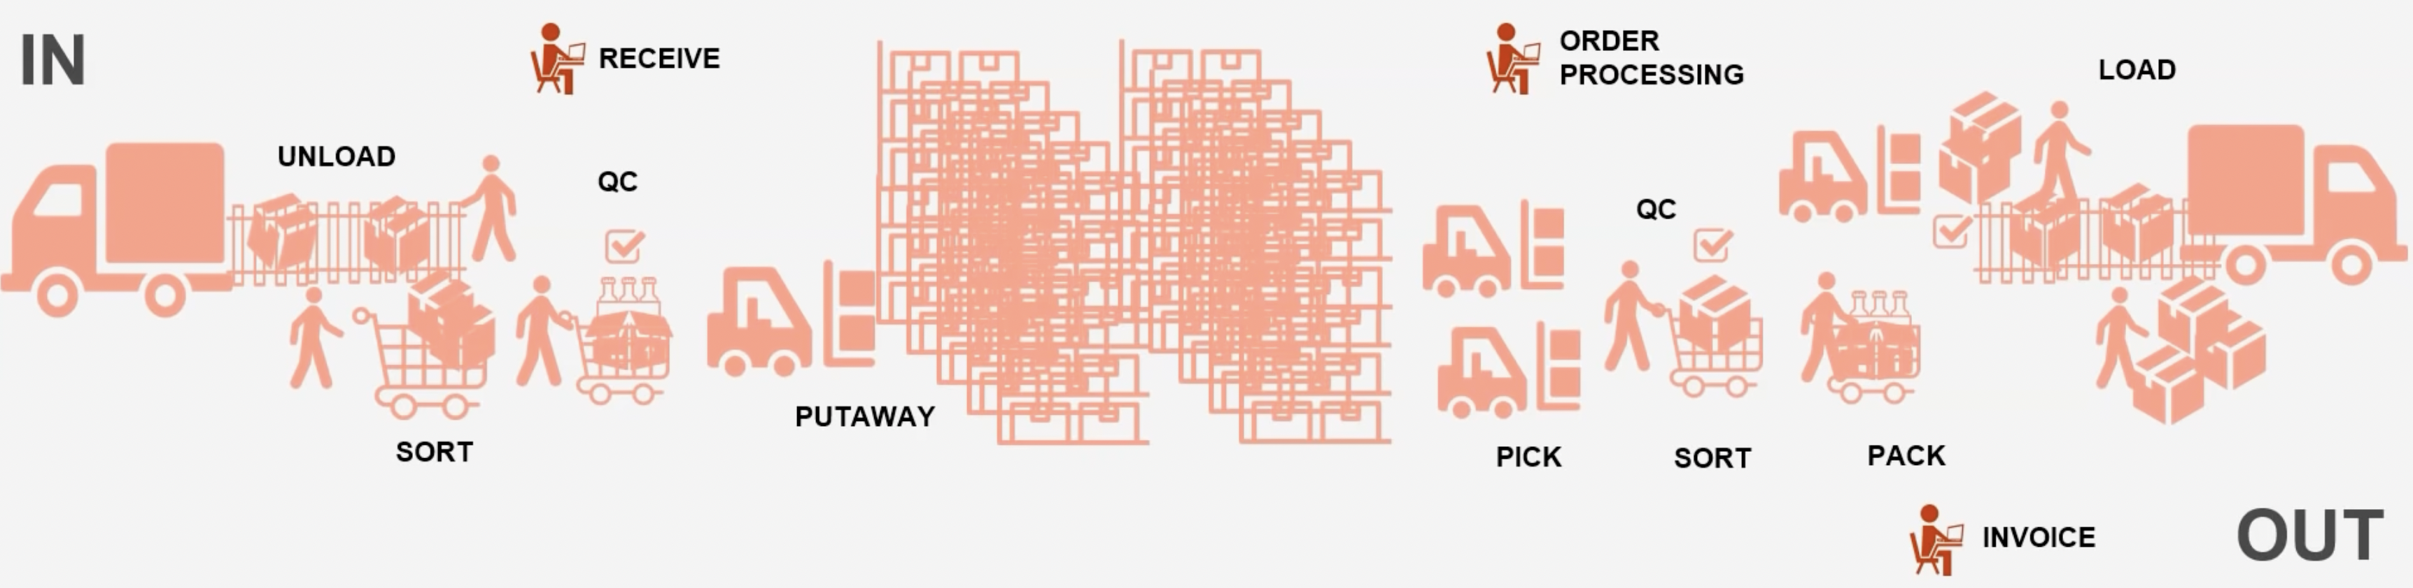
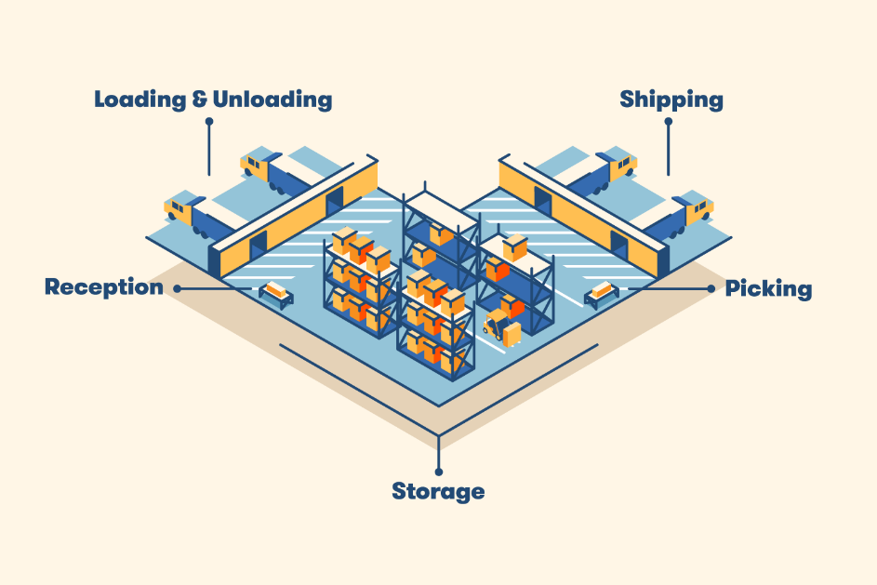
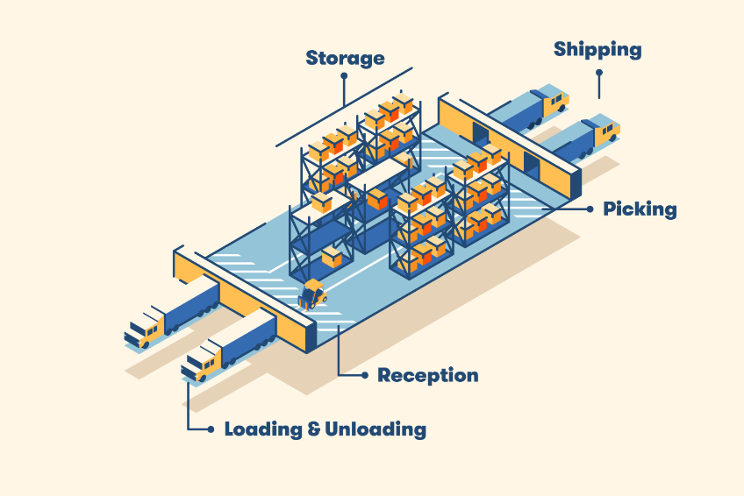
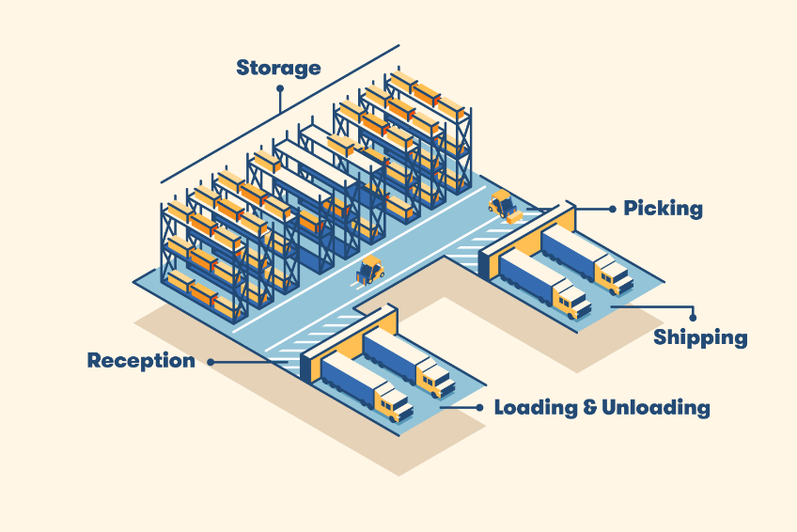
Warehouse and Logistics Essentials - Warehouse Basics
Schematic Diagram of Material Flow in Warehouse
Common Warehouse Layouts
I-shaped warehouse
U-shaped warehouse
L-shaped warehouse

Slide 29
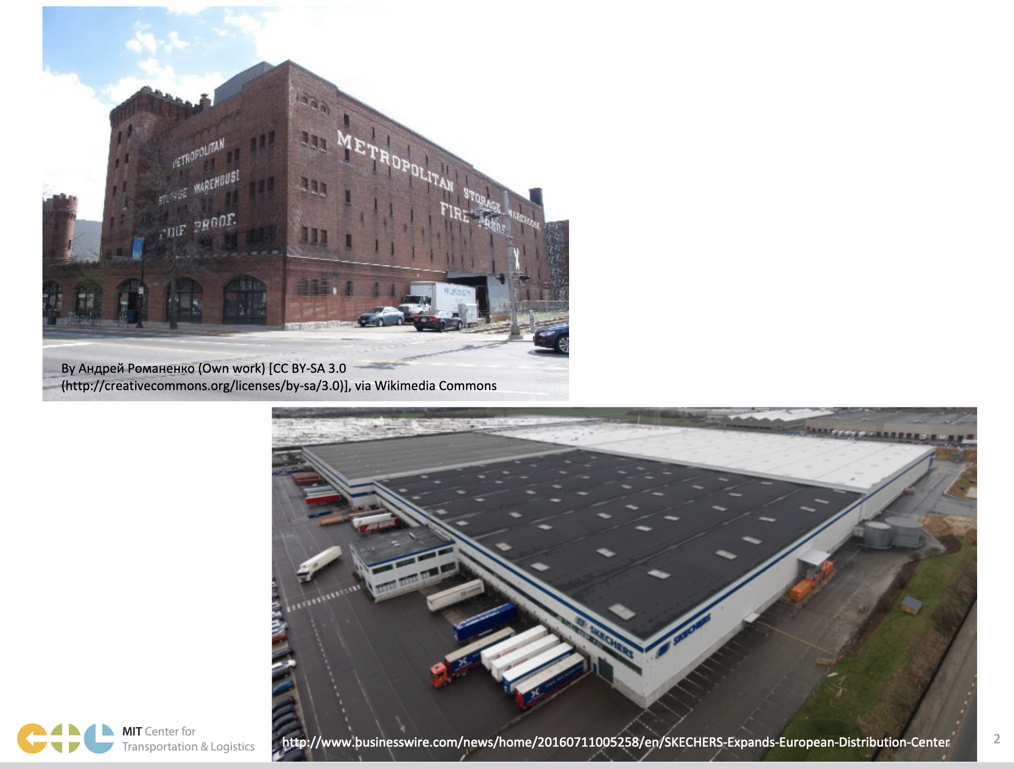
Warehouse and Logistics Essentials – Warehouse vs DC
Warehouse
Purpose is mainly storage of goods
Space utilization is the main KPI for a warehouse
V/S
Distribution Center
Objective is storage of goods as well as flow of goods
Usually have dedicated provision for docks and yards
KPIs that matter are are space utilization and throughput

Slide 30
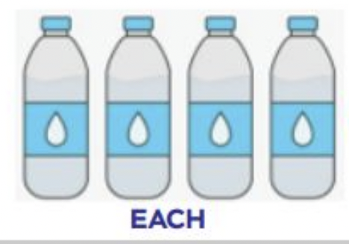
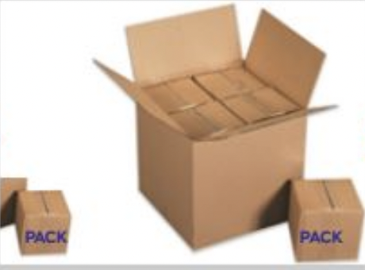
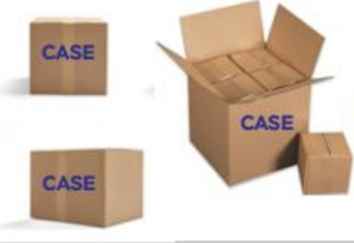
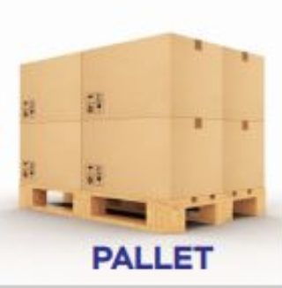
Warehouse and Logistics Essentials – Concept of Unit Load
EACH
PACK
CASE
PALLET
A unit intended for individual sale
Also called sales or consumption unit packaging
Its distribution is not possible with primary packaging
A group of individual units, together in one package
Distribution and storage is done in primary packaging
A standard shipping unit that contain multiple packs
Distribution of goods from W/H to stores usually happens in cases
Also called secondary packaging
A load of several cases
Also called tertiary packaging or unit load
Movement of finished from suppliers to buyers happen on pallet

Slide 31
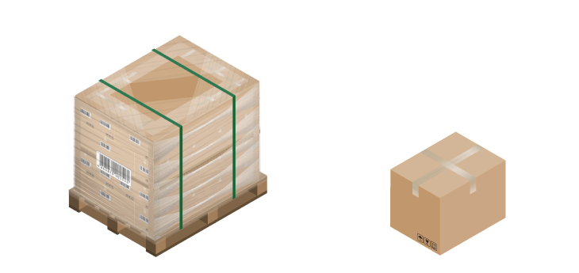
Warehouse and Logistics Essentials – Shipping Options
Parcel shipping
Moves goods in small packages
Involves shipping one box to a customer address at a time, and this is often a direct-to-consumer relationship
Used by shippers who are moving goods to the eventual consumers in the supply chain, like retailers
Parcel shipping typically involves packages that weigh less than 150 lb and could be lifted without any assistance.
V/S
Freight shipping
Moves goods in larger quantities
Involves movement of goods in handling units such as pallets, truckloads, and shipping containers
Used by shippers whose goods are somewhere in the middle of the supply chain, like manufacturers, Wholesalers

Slide 32
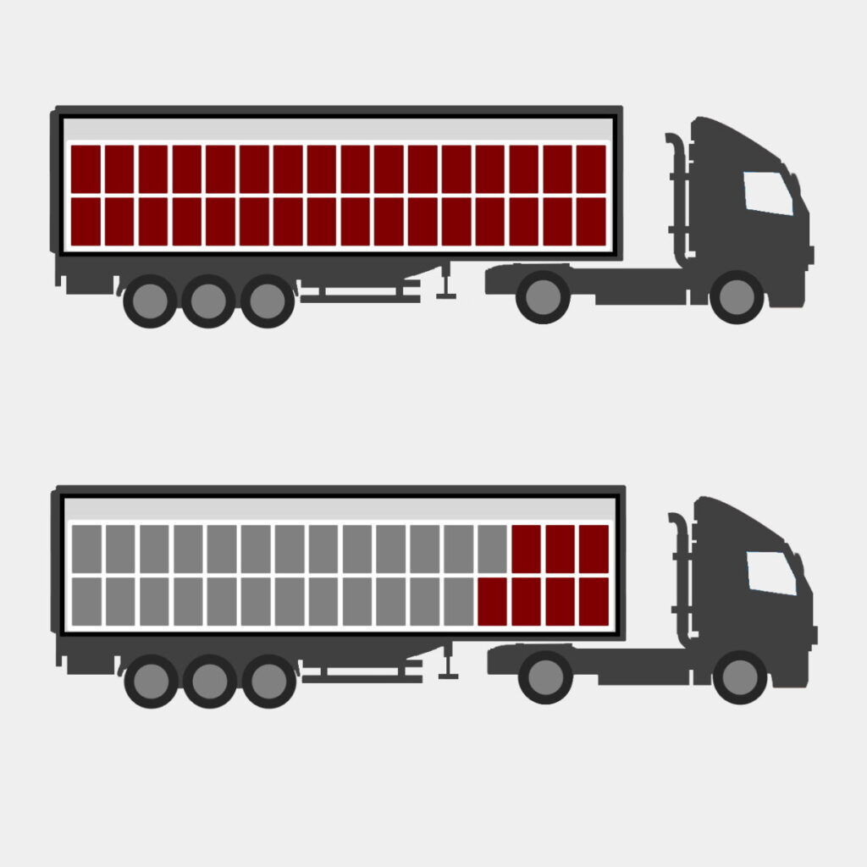
Warehouse and Logistics Essentials – Freight shipping Options
Full Truck Load (FTL)
The entire trailer is filled up with pallets from a single shipper. Faster but expensive, especially if there aren’t enough pallets to fill the truck.
V/S
Less-than-Truck Load (LTL)
The trailer is filled up with pallets from multiple shippers. Load is consolidated with shipment for different locations. Cost-effective and efficient, but slower in delivery from source to destination

Slide 33
Aptos Solution Portfolio Snapshot
Aptos Point of Sale
Fixed
Aptos One Store Selling App
Aptos Order Management System
Aptos Store Fulfillment App
Aptos One Store Inventory Management
Aptos One Unified Promos
Unified Commerce Vertical
Aptos One Enterprise Web Apps
Aptos Customer Relationship Management
Aptos Merchandising
Aptos Warehouse Management System
Aptos Sales Audit
Aptos Analytics
Revionics Vertical
Product Base Pricing
Promotion Planning
Markdown Optimization

Slide 34
Retail 101 Retail Maths

Slide 35


Retail Math
“Retailing is about selling and making money. This is why it is important that we study the calculations of profit.”
Notes:
Retailing is about selling and making money. This is why it is important that we study the calculations of profit.
Retailers do not look to buy new technologies unless they see or understand how these new systems will impact their bottom line.

Slide 36
Margin
Margin: The difference between merchandise cost and the retail price.
is defined and applies to an individual item, a group of items, or the entire merchandise stock of a department, store or company. Margin can be expressed in dollars or percent.
Margin dollars = (Retail price – cost price)
Margin percent = (Retail price – cost price) / Retail Price
Notes:
Markup – is defined and applies to an individual item, a group of items, or the entire merchandise stock of a department, store or company. Markup can be expressed in dollars or percent.
Markup dollars = (Retail price – cost)
Markup percent = (Retail price – cost)/Retail Price
There are numerous purchase planning and merchandising pricing decisions that face a retailer when buying goods for resale. To achieve maximum profits, the same estimated initial markup does not apply to all purchases. There are many competitive and/or environmental issued that a buyer must taking into consideration when establishing the proper markup.

Slide 37
Margin
Buyers decisions when determining Margin
Branded vs. Private Label
Competitive Landscape
Product Life Cycle
Historical performance of like item
Others
Notes:
Establishing the right markup is critical to maximizing profit and is the starting point for the profit calculation.

Slide 38
Markdowns
Markdowns: lowering or reducing of the original or previous retail price on an item or group of items
The most common and most important type of price adjustment is called Markdown.
Markdown $ = (Original Selling Price – New Selling Price)
Markdown % = Markdown $
Net Sales $
“Markdowns are one of the biggest factors in eroding profit in retail organizations.”

Slide 39
Markdowns
Purpose of Markdowns
To stimulate the sale of an item or group of items because of an unsatisfactory response by customers
To attract customers to stores by offering bargains
To meet competitive prices
To provide Open-to-Buy money to purchase new merchandise

Slide 40
Markdowns
The most common causes for Markdowns are:
Buying errors:
Overbuying in quantities
Buying the wrong sizes
Buying poor styles, quality, materials, and colors
Poor timing in ordering goods
Receiving and accepting merchandise that has been shipped late
Notes:
Causes of Markdowns
By analyzing the causes for errors a merchant can make an effort to minimize them. It is important for us because we can see how are technology solutions play a part in minimizing markdowns.
The most common causes for Markdowns are:

Slide 41
Markdowns
The most common causes for Markdowns are:
Pricing Errors
Poor timing of markdowns
Setting the initial price too high
Not being competitive in price for the same goods
Deferring Markdowns too long
Selling Errors
Poor stock keeping
Soiled or damaged goods
Failure to display merchandise properly
Uninformed salespeople

Slide 42
Inventory Turn
Inventory Turn: The number of times, with in a given period that the inventory is sold and replaced.
Every retailer should understand the importance of inventory turn to make better use of capital investment, to control inventory, and ultimately optimize profits.
Indicates whether customers are buying
Inventory Turn = Net sales for period Average stock for same period
Notes:
Turnover
Every retailer should understand the importance of turnover to make better use of capital investment, to control inventory, and ultimately optimize profits.
The term indicates the number of times that an average stock is sold in a given period of time, usually one year. However, turnover can be computed on a weekly, monthly, or seasonal basis. The actual number of turn varies with the type of merchandise and price. Generally speaking, lower price ranges turn more rapidly than higher ranges; apparel and accessories turn more rapidly than home furnishings.
Turnover = Net sales for period
Average stock for same period

Slide 43
Inventory Turn
Inventory Turn is important to a retail operation because it:
Stimulates sales by presenting fresh merchandise to the customer
Reduces markdowns by keeping the flow of new goods constant, thereby curbing the accumulation of large amounts of older stock
Lowers the cost of goods sold because the Open-to-Buy position permits the Buyer to take advantage of special prices and offerings
Decreases interest, merchandise taxes, and other operating expenses as a percentage of net sales
Notes:
Turnover is important to a retail operation because it:
Stimulates sales by presenting fresh merchandise to the customer.
Reduces markdowns by keeping the flow of new goods constant, thereby curbing the accumulation of large amounts of older stock.
Lowers the cost of goods sold because the Open-to-Buy position permits the Buyer to take advantage of special prices and offerings.
Decreases interest, merchandise taxes, and other operating expenses as a percentage of net sales.

Slide 44
Open to Buy
Open to Buy (OTB): the amount of unspent (i.e. order limit) money that is available for purchasing merchandise that will be delivered during a given period.
It represents the difference between planned purchases for a period and the merchandise orders already placed for that period
Open to Buy = Target Sales + Planned Markdown + Planned Closing Inventory – Opening Inventory - Commitments
Notes:
Open-to-Buy
Profit in retailing is determined largely by maintaining a proper proportion between sales and inventory. The merchandiser/planner is responsible for providing an inventory that reflects customer demand and that also remains within the financial limits set by management.

Slide 45
Open to Buy
Why is managing an OTB so important?
Over spending can cause markdowns and erode profitability
Over spending can cause your store to be visually unappealing which could negatively affect sales
Over spending ties up capital and adds to interest charges
Under spending can cause you to miss sales
Under spending can create empty bins which has a negative impact on sales and customer retention

Slide 46
Profit
The calculation of profit is used to:
Exchange data and compare stores to determine strengths and weaknesses
Indicate the direction of the business and whether it is prosperous, struggling for survival, or bankrupt
Provide a statement for analysis so that knowledgeable changes in management or policy can be made
Improve the profit margin by using this analysis
Notes:
When we talk to retailers, we need to talk to them in terms of improving their profit results. The calculation of profit is used to:
Exchange data and compare stores to determine strengths and weaknesses.
Indicate the direction of the business and whether it is prosperous, struggling for survival, or bankrupt.
Provide a statement for analysis so that knowledgeable changes in management or policy can be made.
Improve the profit margin by using this analysis.
In this section, we will discuss the basic profit elements, their relationship to each other, the final profit and loss statements and methods to manipulate these elements to improve profits will be examined.

Slide 47
Basic profit factors
The four basic merchandising factors that directly affect profit results are:
Operating Income (retailers refer to this as sales volume, which is a net sales figure)
Cost Of Goods Sold
Gross Margin
Operating Expenses
Notes:
Defining Basic Profit Factors

Slide 48
Income Statement
Gross sales are the total initial dollars received for Merchandise sold during a given period
Gross sales = Total of all the prices charged to consumers on individual items x number of units actually sold

Slide 49
Operating income
Net Sales
Net sales are the total for a given period after Customer Returns and Allowances have been deducted from gross sales
Customer Returns and Allowances
These are important factors because the customer gets a complete refund of the purchase price, or a partial rebate, and a deduction must be made from the gross sales figure because there is a cancellation of the sale
Customer Returns and Allowances – Total of all refunds or credits to the customer on individual items x actual number of units actually returned
Net Sales = Gross Sales – Customer returns and Allowances
Notes:
In Retailing, operating income is also known as net sales. The net sales figure is also called Sales Volume and is used to measure a departments performance or productivity. It is common practice to calculate the percentage of sales that an individual department has contributed to total store sales. This type of analysis allows a retailer to compare its contribution to other departments within the company as well as compare its contribution to similar departments in the industry or among its competitors. These figures are published annually by the National Retail Federation and are key performance indicators which help retailers identify opportunities.

Slide 50
Cost of goods sold (COGS)
COGS is the cost directly related to selling a product during an operating period
COGS is calculated by adding total product cost (after cash discounts), transportation charges, and merchandise preparation costs
When COGS is subtracted from the sales revenue, you get Gross Profit Margin (GM)
Do not confuse cost with price, which is what the company charges its customers for products or services

Slide 51
Cost of goods sold (COGS)
Since COGS has a direct impact on sales and gross margin, it is important to understand if the cost of goods is trending up or down
Many items impact COGS and can be examined to understand if value can be created
Vendor terms and discounts, rebates, rush orders, drop shipments and shrinkage are a few examples of items that can impact cost

Slide 52
Total Cost of Merchandise sold
Cost of Merchandise Sold = the cost of purchases with the necessary adjustments of:
Billed Cost = Vendor invoiced cost
Plus
Inward Freight or Transportation = This is the amount that the vendor may charge for delivery of merchandise
Minus
Cash Discounts = These are discounts that vendors may grant for payment of invoice within a specified time. For example, 2% discount from the total billed cost if invoice is paid within 30 days of receipt

Slide 53
Gross Margin
The difference between net sales and cost of merchandise sold. This figure must be large enough to cover operating expenses and to allow for a reasonable profit
Gross Margin dollars = Net Sales – Total Cost of Merchandise Sold

Slide 54
Gross Margin Percent
The difference between net sales and cost of merchandise sold divided by net sales. This percentage is a key performance indicator and an industry standard for evaluating gross margin
Gross Margin Percent =
(Net Sales – Cost of Mdse. Sold) / Net Sales

Slide 55
Operating Expenses
Because the expenses of operating a business are deducted from the Gross Margin to determine whether or not a net profit is achieved, the control and management of these expenses are of major concern
Notes:
Because the expenses of operating a business are deducted from the Gross Margin to determine whether or not a net profit is achieved, the control and management of these expenses are of major concern.
Traditionally, operating expenses fall into two major categories and are charged to a merchandise department to determine its net profit. These major categories are:

Slide 56
Operating Expenses
Direct Expenses
Exist only with a given department and cease if that department is discontinued
Store Salaries
Buying office Salaries
Traveling Expenses
Advertising Expenses
Selling Supplies
Selling Space – Rent
Indirect Expenses
Expenses that exist even if the particular department is discontinued.
Maintenance
Insurance
Security
Depreciation of equipment
Salaries of Senior Executives
Notes:
Other expenses may include Interest Expense = On inventory or other debt taxes

Slide 57
Retail Math
The relationship of the basic profit factors
Net sales volume = $100,000 100% (Operating Income)
Cost of Mdse. Sold - $55,000 55%
($55,000/$100,000)
Operating Expenses - $43,000 43%
($43,000/$100,000)
Profit $ 2,000 2% ($2,000/$100,000)
Notes:
The Relationship of the Basic Profit Factors
The following example shows the relationship of the three fundamental factors upon which the amount of profit depends. For comparison, these factors are expressed in percentages as well as in dollars.
Net sales volume = $100,000 100%
(Operating Income)
- Cost of Mdse. Sold - $55,000 55% ($55,000/$100,000)
- Operating Expenses - $43,000 43% ($43,000/$100,000)
Profit $ 2,000 2% ($2,000/$100,000)

Slide 58
Retail Math
How to increase profits:
Increase sales while there is only a proportionate increase in cost of Merchandise sold, and little to no increase in expenses.
Decrease the cost of merchandise sold without a decrease in sales (e.g. selling a larger proportion of higher mark-up merchandise, or decreasing the net cost of goods sold by lowering shipping charges and/or obtaining greater cash discounts)
Reduce Expenses
Notes:
How to Increase Profits:
Realistically it is impossible to list everything a retailer needs to know to merchandise at a profit because the factors that govern profits are variable. After reviewing the variables involved in a Profit and Loss Statement however, and seeing how these factors affect profit, certain measures can be taken to improve profit. Fundamentally, an approach to improve profits can be to:
Increase sales while there is only a proportionate increase in cost of
Merchandise sold, and little to no increase in expenses.
Decrease the cost of merchandise sold without a decrease in sales (e.g. selling a larger proportion of higher mark-up merchandise, or decreasing the net cost of goods sold by lowering shipping charges and/or obtaining greater cash discounts)
Reduce Expenses

Slide 59
Thanks!

